Slide 1

Biztech Knowledge Club
PHP Training - PHP +MySQL

Slide 2
Objectives
Connect to MySQL from PHP
Learn how to handle MySQL errors
Execute SQL statements with PHP
Use PHP to work with MySQL databases and tables
Use PHP to manipulate database records
‹#›
Notes:
‹#›

Slide 3
PHP Overview
PHP has the ability to access and manipulate any database that is ODBC compliant
PHP includes functionality that allows you to work directly with different types of databases, without going through ODBC
PHP supports SQLite, database abstraction layer functions, and PEAR DB
‹#›
Notes:
‹#›

Slide 4
Enabling MySQL Support in PHP
On UNIX/Linux systems:
Configure PHP to use the mysqli extension by specifying the --with-mysqli parameter when you run the configure command during installation
On Windows:
Copy the files libmysql.dll and php_mysqli.dll to the installation directory
Edit the php.ini configuration file and enable the extension=php_mysqli.dll directive
‹#›
Notes:
‹#›

Slide 5
Opening and Closing a MySQL Connection
Open a connection to a MySQL database server with the mysqli_connect() function
The mysqli_connect() function returns a positive integer if it connects to the database successfully or false if it does not
Assign the return value from the mysqli_connect() function to a variable that you can use to access the database in your script
‹#›
Notes:
‹#›

Slide 6
Opening and Closing a MySQL Connection (continued)
The syntax for the mysqli_connect() function is:
$connection = mysqli_connect("host", "user ", "password", "database")
The host argument specifies the host name where your MySQL database server is installed
The user and password arguments specify a MySQL account name and password
The database argument selects a database with which to work
‹#›
Notes:
‹#›

Slide 7
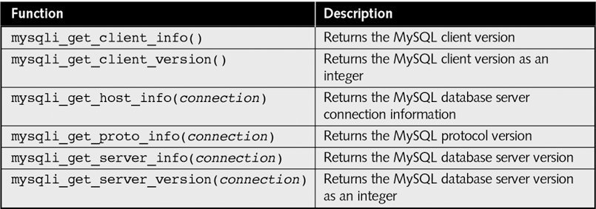
Opening and Closing a MySQL Connection (continued)
Table 9-1 MySQL server information functions
‹#›
Notes:
‹#›

Slide 8
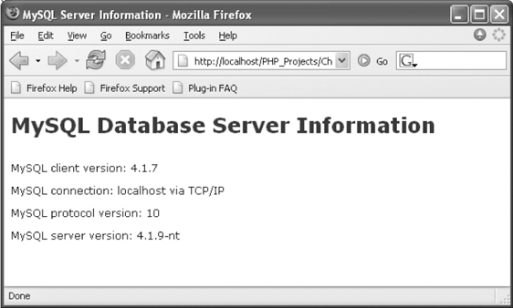
Opening and Closing a MySQL Connection (continued)
Figure 9-1 MySQLInfo.php in a Web browser
‹#›
Notes:
‹#›

Slide 9
Selecting a Database
Select a database with the use database statement when you log on to the MySQL Monitor
The syntax for the mysqli_select_db() function is:
mysqli_select_db(connection, database)
The function returns a value of true if it successfully selects a database or false if it does not
‹#›
Notes:
‹#›

Slide 10
Handling MySQL Errors
Reasons for not connecting to a database server include:
The database server is not running
Insufficient privileges to access the data source
Invalid username and/or password
‹#›
Notes:
‹#›

Slide 11
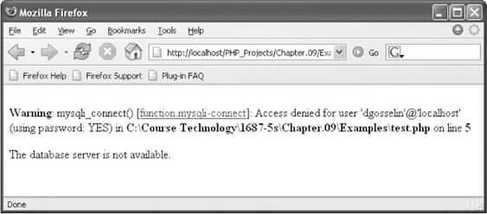
Handling MySQL Errors (continued)
Make sure you are using a valid username and password
Figure 9-2 Database connection error message
‹#›
Notes:
‹#›

Slide 12
Terminating Script Execution
The die() and exit() functions terminate script execution
The die() version is usually used when attempting to access a data source
Both functions accept a single string argument
Call the die() and exit() functions as separate statements or by appending either function to an expression with the Or operator
‹#›
Notes:
‹#›

Slide 13
Terminating Script Execution (continued)
$DBConnect = @mysqli_connect("localhost", "root", "paris");
if (!$DBConnect)
die("<p>The database server is not available.</p>");
echo "<p>Successfully connected to the database server.</p>";
$DBSelect = @mysqli_select_db($DBConnect, "flightlog");
if (!$DBSelect)
die("<p>The database is not available.</p>");
echo "<p>Successfully opened the database.</p>";
// additional statements that access the database
mysqli_close($DBConnect);
‹#›
Notes:
‹#›

Slide 14
Terminating Script Execution (continued)
$DBConnect = @mysqli_connect("localhost", "dongosselin",
"rosebud")
Or die("<p>The database server is not available.</p>");
echo "<p>Successfully connected to the database server.</p>";
@mysqli_select_db($DBConnect, "flightlog")
Or die("<p>The database is not available.</p>");
echo "<p>Successfully opened the database.</p>";
// additional statements that access the database server
mysqli_close($DBConnect);
‹#›
Notes:
‹#›

Slide 15
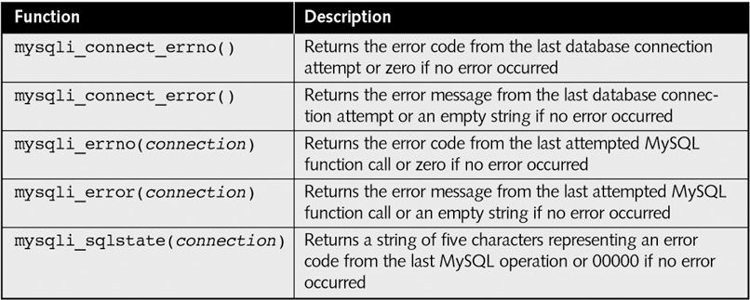
Reporting MySQL Errors
Table 9-2 MySQL error reporting functions
‹#›
Notes:
‹#›

Slide 16
Reporting MySQL Errors
$User = $_GET['username'];
$Password = $_GET['password'];
$DBConnect = @mysqli_connect("localhost", $User, $Password)
Or die("<p>Unable to connect to the database server.</p>“ . "<p>Error code " . mysqli_connect_errno()
. ": " . mysqli_connect_error()) . "</p>";
echo "<p>Successfully connected to the database server.</p>";
@mysqli_select_db($DBConnect, "flightlog")
Or die("<p>The database is not available.</p>");
echo "<p>Successfully opened the database.</p>";
// additional statements that access the database
mysqli_close($DBConnect);
‹#›
Notes:
‹#›

Slide 17
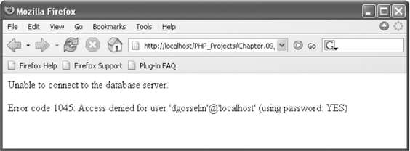
Reporting MySQL Errors (continued)
Figure 9-4 Error number and message generated by
an invalid username and password
‹#›
Notes:
‹#›

Slide 18
Reporting MySQL Errors
$User = $_GET['username'];
$Password = $_GET['password'];
$DBConnect = @mysqli_connect("localhost", $User, $Password)
Or die("<p>Unable to connect to the database server.</p>"
. "<p>Error code " . mysqli_connect_errno()
. ": " . mysqli_connect_error()) . "</p>";
echo "<p>Successfully connected to the database server.</p>";
@mysqli_select_db($DBConnect, "flightplan")
Or die("<p>Unable to select the database.</p>"
. "<p>Error code " . mysqli_errno($DBConnect)
. ": " . mysqli_error($DBConnect)) . "</p>";
echo "<p>Successfully opened the database.</p>";
// additional statements that access the database
mysqli_close($DBConnect);
‹#›
Notes:
‹#›

Slide 19
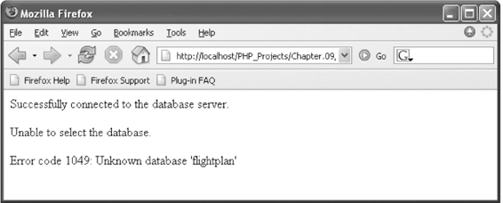
Reporting MySQL Errors (continued)
Figure 9-5 Error code and message generated when
attempting to select a database that does not exist
‹#›
Notes:
‹#›

Slide 20
Executing SQL Statements
Use the mysqli_query() function to send SQL statements to MySQL
The syntax for the mysqli_query() function is:
mysqli_query(connection, query)
The mysqli_query() function returns one of three values:
For SQL statements that do not return results (CREATE DATABASE and CREATE TABLE statements) it returns a value of true if the statement executes successfully
‹#›
Notes:
‹#›

Slide 21
Executing SQL Statements (continued)
For SQL statements that return results (SELECT and SHOW statements) the mysqli_query() function returns a result pointer that represents the query results
A result pointer is a special type of variable that refers to the currently selected row in a resultset
The mysqli_query() function returns a value of false for any SQL statements that fail, regardless of whether they return results
‹#›
Notes:
‹#›

Slide 22
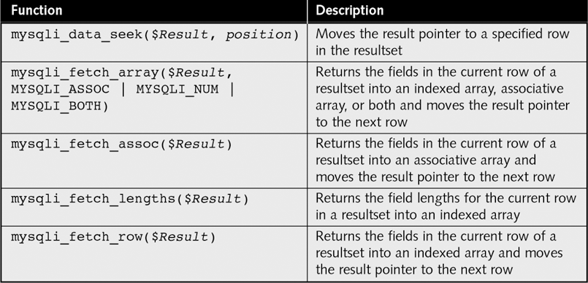
Working with Query Results
Table 9-3 Common PHP functions for accessing database results
‹#›
Notes:
‹#›

Slide 23
Retrieving Records into an Indexed Array
The mysqli_fetch_row() function returns the fields in the current row of a resultset into an indexed array and moves the result pointer to the next row
echo "<table width='100%‘ border='1'>";
echo "<tr><th>Make</th><th>Model</th>
<th>Price</th><th>Quantity</th></tr>";
$Row = mysqli_fetch_row($QueryResult);
do {
echo "<tr><td>{$Row[0]}</td>";
echo "<td>{$Row[1]}</td>";
echo "<td align='right'>{$Row[2]}</td>";
echo "<td align='right'>{$Row[3]}</td></tr>";
$Row = mysqli_fetch_row($QueryResult);
} while ($Row);
‹#›
Notes:
‹#›

Slide 24
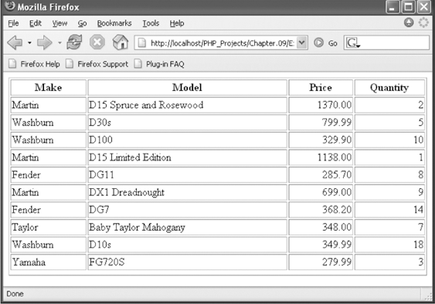
Retrieving Records into an Indexed Array
Figure 9-6 Output of the inventory table in a Web browser
‹#›
Notes:
‹#›

Slide 25
Retrieving Records into an Associative Array
The mysqli_fetch_assoc() function returns the fields in the current row of a resultset into an associative array and moves the result pointer to the next row
The difference between mysqli_fetch_assoc() and mysqli_fetch_row() is that instead of returning the fields into an indexed array, the mysqli_fetch_assoc() function returns the fields into an associate array and uses each field name as the array key
‹#›
Notes:
‹#›

Slide 26
Accessing Query Result Information
The mysqli_num_rows() function returns the number of rows in a query result
The mysqli_num_fields() function returns the number of fields in a query result
Both functions accept a database connection variable as an argument
‹#›
Notes:
‹#›

Slide 27
Accessing Query Result Information
$SQLstring = "SELECT * FROM inventory";
$QueryResult = @mysqli_query($DBConnect, $SQLstring)
Or die("<p>Unable to execute the query.</p>"
. "<p>Error code “ . mysqli_errno($DBConnect)
. ": " . mysqli_error($DBConnect)) . "</p>";
echo "<p>Successfully executed the query.</p>";
$NumRows = mysqli_num_rows($QueryResult);
$NumFields = mysqli_num_fields($QueryResult);
if ($NumRows != 0 && $NumFields != 0)
echo "<p>Your query returned “ .
mysqli_num_rows($QueryResult) . “ rows and "
. mysqli_num_fields($QueryResult) . “ fields.</p>";
else
echo "<p>Your query returned no results.</p>";
mysqli_close($DBConnect);
‹#›
Notes:
‹#›

Slide 28
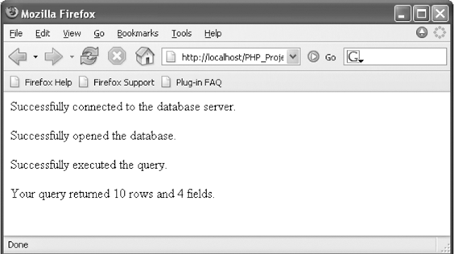
Accessing Query Result Information
Figure 9-8 Output of the number of rows and fields returned from a query
‹#›
Notes:
‹#›

Slide 29
Closing Query Results
When you are finished working with query results retrieved with the mysqli_query() function, use the mysqli_free_result() function to close the resultset
To close the resultset, pass to the mysqli_free_result() function the variable containing the result pointer from the mysqli_query() function
‹#›
Notes:
‹#›

Slide 30
Creating and Deleting Databases
Use the CREATE DATABASE statement with the mysqli_query() function to create a new database
$SQLstring = "CREATE DATABASE real_estate";
$QueryResult = @mysqli_query($DBConnect, $SQLstring)
Or die("<p>Unable to execute the query.</p>"
. "<p>Error code " . mysqli_errno($DBConnect)
. ": " . mysqli_error($DBConnect)) . "</p>";
echo "<p>Successfully executed the query.</p>";
mysqli_close($DBConnect);
‹#›
Notes:
‹#›

Slide 31
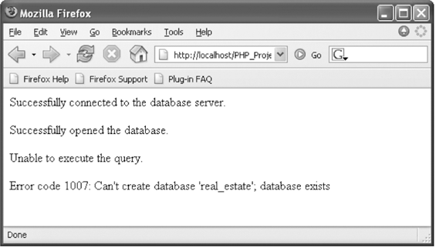
Creating and Deleting Databases
Figure 9-9 Error code and message that prints when you attempt
to create a database that already exists
‹#›
Notes:
‹#›

Slide 32
Creating and Deleting Databases
Use the mysqli_db_select() function to check whether a database exists before you create or delete it
To use a new database, you must select it by executing the mysqli_select_db() function
Deleting a database is almost identical to creating one, except use the DROP DATABASE statement instead of the CREATE DATABASE statement with the mysqli_query() function
‹#›
Notes:
‹#›

Slide 33
Creating and Deleting Databases
$DBName = "real_estate";
...
if (@!mysqli_select_db($DBConnect, $DBName))
echo "<p>The $DBName database does not exist!</p>";
else {
$SQLstring = "DROP DATABASE $DBName";
$QueryResult = @mysqli_query($DBConnect, $SQLstring)
Or die("<p>Unable to execute the query.</p>"
. "<p>Error code “ . mysqli_errno($DBConnect)
. ": “ . mysqli_error($DBConnect)) . "</p>";
echo "<p>Successfully deleted the database.</p>";
}
mysqli_close($DBConnect);
‹#›
Notes:
‹#›

Slide 34
Creating and Deleting Tables
To create a table, use the CREATE TABLE statement with the mysqli_query() function
Execute the mysqli_select_db() function before executing the CREATE TABLE statement or the new table might be created in the wrong database
To prevent code from attempting to create a table that already exists, use a mysqli_query() function that attempts to select records from the table
‹#›
Notes:
‹#›

Slide 35
Creating and Deleting Tables
$DBName = "real_estate";
...
$SQLstring = "CREATE TABLE commercial (city VARCHAR(25), state VARCHAR(25), sale_or_lease VARCHAR(25), type_of_use VARCHAR(40),Price INT, size INT)";
$QueryResult = @mysqli_query($DBConnect, $SQLstring)
Or die("<p>Unable to execute the query.</p>"
. "<p>Error code " . mysqli_errno($DBConnect)
. ": " . mysqli_error($DBConnect)) . "</p>";
echo "<p>Successfully created the table.</p>";
mysqli_close($DBConnect);
‹#›
Notes:
‹#›

Slide 36
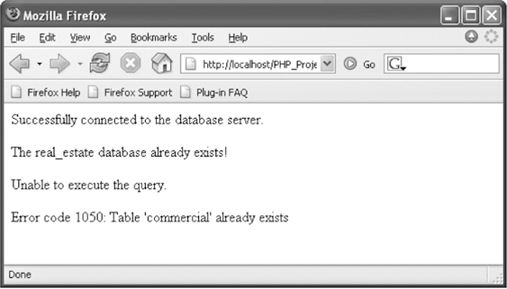
Creating and Deleting Tables
Figure 9-11 Error code and message that prints when you attempt to create a table that already exists
‹#›
Notes:
‹#›

Slide 37
Adding, Deleting, and Updating Records
To add records to a table, use the INSERT and VALUES keywords with the mysqli_query() function
The values entered in the VALUES list must be in the same order in which you defined the table fields
You must specify NULL in any fields for which you do not have a value
‹#›
Notes:
‹#›

Slide 38
Adding, Deleting, and Updating Records
To add multiple records to a database, use the LOAD DATA statement and the mysqli_query() function with a local text file containing the records you want to add
To update records in a table, use the UPDATE, SET, and WHERE keywords with the mysqli_query() function
‹#›
Notes:
‹#›

Slide 39
Adding, Deleting, and Updating Records
The UPDATE keyword specifies the name of the table to update
The SET keyword specifies the value to assign to the fields in the records that match the condition in the WHERE keyword
To delete records in a table, use the DELETE and WHERE keywords with the mysqli_query() function
The WHERE keyword determines which records to delete in the table
‹#›
Notes:
‹#›

Slide 40
Using the mysqli_affected_rows() Function
With queries that return results (SELECT queries), use the mysqli_num_rows() function to find the number of records returned from the query
With queries that modify tables but do not return results (INSERT, UPDATE, and DELETE queries), use the mysqli_affected_rows() function to determine the number of affected rows
‹#›
Notes:
‹#›

Slide 41
Using the mysqli_affected_rows() Function
$SQLstring = "UPDATE inventory SET price=368.20
WHERE make='Fender' AND model='DG7'";
$QueryResult = @mysqli_query($DBConnect, $SQLstring)
Or die("<p>Unable to execute the query.</p>"
. "<p>Error code " . mysqli_errno($DBConnect)
. ": " . mysqli_error($DBConnect)) . "</p>";
echo "<p>Successfully updated "
. mysqli_affected_rows($DBConnect) . " record(s).</p>";
‹#›
Notes:
‹#›

Slide 42
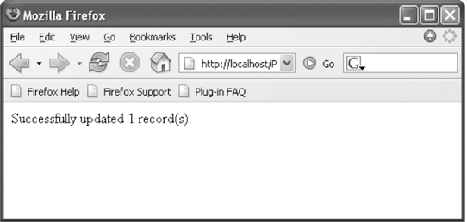
Using the mysqli_affected_rows() Function (continued)
Figure 9-16 Output of mysqli_affected_rows() function for an UPDATE query
‹#›
Notes:
‹#›

Slide 43
Using the mysqli_info() Function
For queries that add or update records, or alter table’s structure, use the mysqli_info() function to return information about the query
The mysqli_info() function returns the number of operations for various types of actions, depending on the type of query
The mysqli_info() function returns information about the last query that was executed on the database connection
‹#›
Notes:
‹#›

Slide 44
Using the mysqli_info() Function
The mysqli_info() function returns information about queries that match one of the following formats:
INSERT INTO...SELECT...
INSERT INTO...VALUES (...),(...),(...)
LOAD DATA INFILE ...
ALTER TABLE ...
UPDATE
For any queries that do not match one of these formats, the mysqli_info() function returns an empty string
‹#›
Notes:
‹#›

Slide 45
Using the mysqli_info() Function
$SQLstring = "INSERT INTO inventory
VALUES('Ovation', '1777 LX Legend', 1049.00, 2),
('Ovation', '1861 Standard Balladeer', 699.00, 1),
('Ovation', 'Tangent Series T357', 569.00, 3)";
$QueryResult = @mysqli_query($DBConnect, $SQLstring)
Or die("<p>Unable to execute the query.</p>"
. "<p>Error code “ . mysqli_errno($DBConnect)
. ": " . mysqli_error($DBConnect)) . "</p>";
echo "<p>Successfully added the records.</p>";
echo "<p>" . mysqli_info($DBConnect) . "</p>";
‹#›
Notes:
‹#›

Slide 46
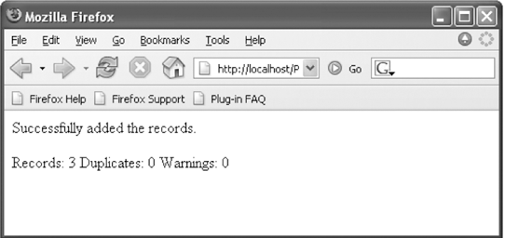
Using the mysqli_info() Function
Figure 9-17 Output of mysqli_info() function for an INSERT query that adds multiple records
‹#›
Notes:
‹#›

Slide 47
Using the mysqli_info() Function
The mysqli_info() function also returns information for LOAD DATA queries
$SQLstring = "LOAD DATA LOCAL INFILE 'c:/temp/inventory.txt'
INTO TABLE inventory;";
$QueryResult = @mysqli_query($DBConnect, $SQLstring)
Or die("<p>Unable to execute the query.</p>"
. "<p>Error code “ . mysqli_errno($DBConnect)
. ": " . mysqli_error($DBConnect)) . "</p>";
echo "<p>Successfully added the records.</p>";
echo "<p>" . mysqli_info($DBConnect) . "</p>";
‹#›
Notes:
‹#›

Slide 48
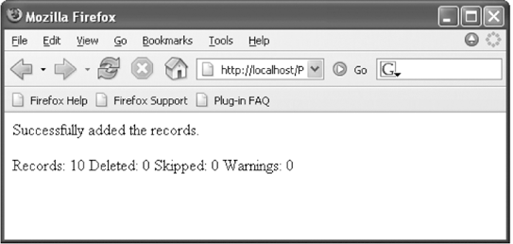
Using the mysqli_info() Function
Figure 9-18 Output of mysqli_info() function for a
LOAD DATA query
‹#›
Notes:
‹#›

Slide 49
Summary
PHP includes functionality that allows you to work directly with different types of databases, without going through ODBC
Writing code that anticipates and handles potential problems is often called bulletproofing
The error control operator (@) suppresses error messages
A result pointer is a special type of variable that refers to the currently selected row in a resultset
‹#›
Notes:
‹#›

Slide 50
Summary (continued)
Use the mysqli_query() function to send SQL statements to MySQL
To identify a field as a primary key in MySQL, include the PRIMARY KEY keywords when you first define a field with the CREATE TABLE statement
The AUTO_INCREMENT keyword is often used with a primary key to generate a unique ID for each new row in a table
‹#›
Notes:
‹#›

Slide 51
Summary (continued)
You use the LOAD DATA statement and the mysqli_query() function with a local text file to add multiple records to a database
With queries that return results, such as SELECT queries, you can use the mysqli_ num_rows() function to find the number of records returned from the query
The mysqli_info() function returns the number of operations for various types of actions, depending on the type of query
‹#›
Notes:
‹#›

Slide 52
EXPRESS SLIDES Of PHP+SQL

Slide 53
PHP for Database Access
Connect to the MySQL server
$connection = mysql_connect("localhost", $username, $password);
Access the database
mysql_select_db("winestore", $connection);
Perform SQL operations
Disconnect from the server
mysql_close($connection);

Slide 54
Error Handling
All mysql_ functions return NULL (or false) if they fail.
Several functions are helpful in graceful failure
die(string) - halts and displays the string
mysql_errno() - returns number of error
mysql_error() - returns text of error

Slide 55
Error Handling examples
if (!($connection = mysql_connect("localhost",$name,$passwd)))
die("Could not connect");
function showerror()
{
die("Error " . mysql_errno() . " : " . mysql_error());
}
if (!(mysql_select_db("winestor", $connection)))
showerror();

Slide 56
Building a Query
Directly
$query = 'select * from wines';
Using input information
$winery = $_POST['winery'];
$query = “select * from wines where winery=$winery”;

Slide 57
Running a Query
mysql_query returns a result handle
$result = mysql_query($query, $connection)
mysql_num_rows indicates the number of rows returned
$num_rows = mysql_num_rows($result)
mysql_fetch_array creates array/hash of result
For ($n=0; $n<$num_rows;$n++)
$row = mysql_fetch_array($result)

Slide 58
Result of fetch_array
Contains both numeric and index tags
Values are duplicated
Example:
Query: select surname, city from customers;
Row: ( 0=>'Walker', ‘surname’=>'Walker', 1=>'Kent', 'city'=>'Kent' );

Slide 59
Printing the Complete Row
By number
for ($i=0; $i<mysql_num_fields($result); $i++)
echo $row[$i] . " ";
By field
echo $row['surname'] . ' ' . $row['city'];

Slide 60
Avoiding Special Characters
When building HTML, characters such as '&' in the data can cause problems
Function htmlspecialchars() replaces all such characters with HTML escapes such as &amp;
print( htmlspecialchars($row['surname'] . ' ' . $row['city']);

Slide 61
Special Characters in Input
The same problem exists with special characters in input (e.g. ' )
PHP switch magic_quotes_gpc (default on) inserts backslashes before single & double quotes, backslashes and NULL characters in input data (from GET, PUT and cookie data)
Use stripslashes() to remove the slashes
Use addslashes() to add the slashes if magic_quotes_gpc is off

Slide 62
Avoid Dangerous User Input
Passing user input to other programs opens the door to exploits
Eg. exec("/usr/bin/cal $input")
Generates a calendar (/usr/bin/cal 2004)
But a malevolent user might send '2004 ; cat /etc/passwd' or '2004 ; rm *'
Overlong inputs can also cause problems
Always clean input
$input = escapeshellcmd($input);
$input = substr($input,$maxlength);

Slide 63
PHP / Form in one Document
Combine the original form with the PHP document that processes data
if empty($regionName)) { //parameter provided?
//produce the <form>
}
else {
//run the query using data from $_GET or $_POST
}

Slide 64
Inserting Into a Database
Collect data from a form
Validate data (JavaScript, PHP or both)
Create a query
$query = "insert into customer set cust_id = NULL, " . "surname =\"" . $surname ."\"" …
Run the query
mysql_query($query, $db);

Slide 65
Updating a Database
Query to find item to update
Present old information
Collect new information
Validate
Construct and run the update query

